Slide 1
Model Evaluation
PLN

Slide 2
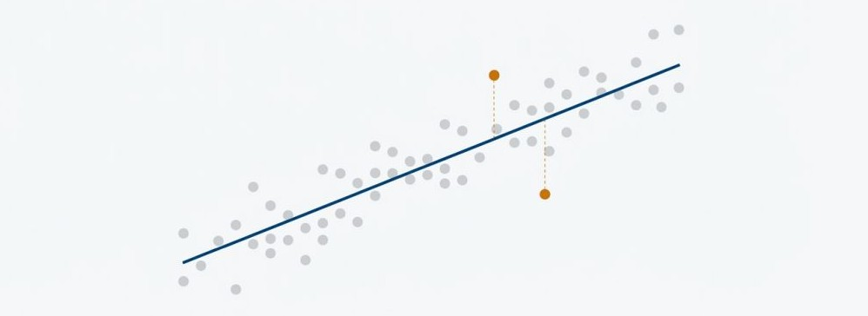
Regression Model

Slide 3
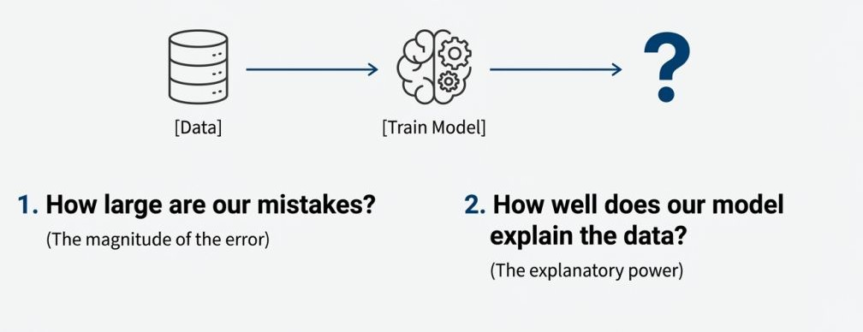
You Model is Trained. Now What ?
Ask 2 fundamental questions

Slide 4
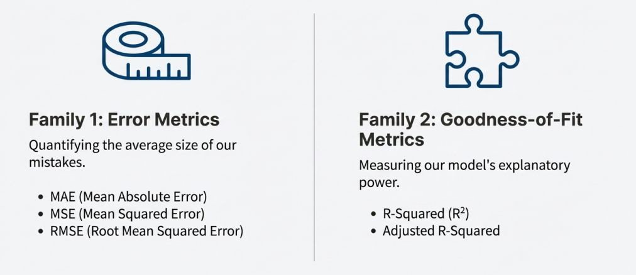
Framework for Evaluation

Slide 5
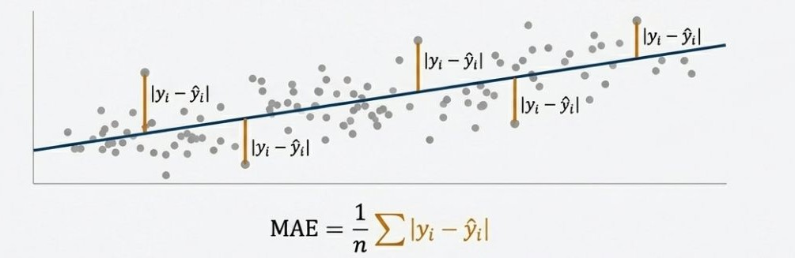
Mean Absolute Error (MAE)
Advantages:
  Robust to outlier: Less affected by a few extreme errors.
Disadvantages:
  The Math Problem: The absolute value function is not differentiable at zero, which creates problems for optimization algorithms like Gradient Descent.

Slide 6
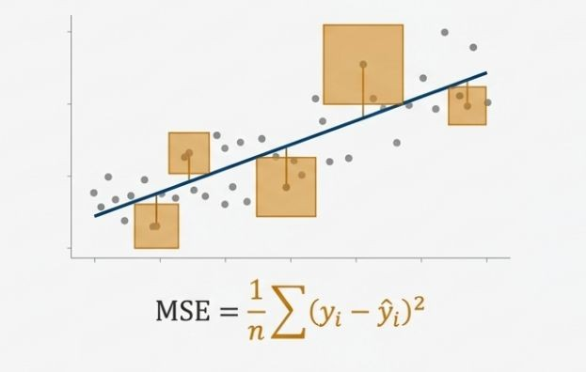
Mean Squared Error (MSE)
Advantages:
  Differentiable at each point.
Disadvantages:
  Sensitive to outliers due to squaring

Slide 7
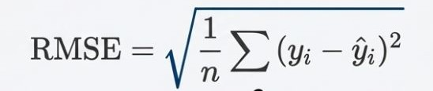

RMSE: The Best of Both Worlds

Slide 8
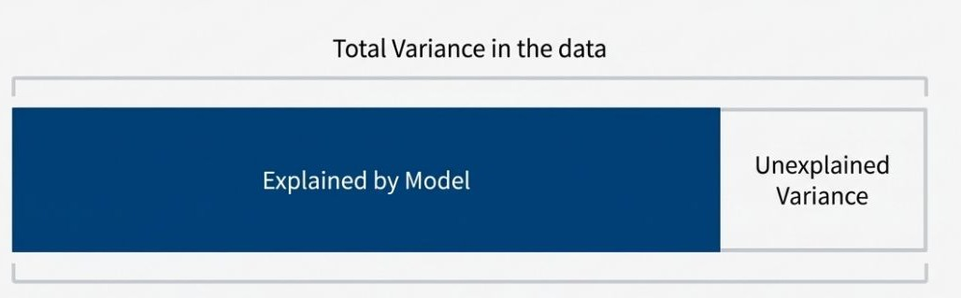
How Much Does Our Model Explain?
Instead of focusing on the error itself, we want to know what proportion of the change (or "variance") in our output is predictable from our inputs.

Slide 9
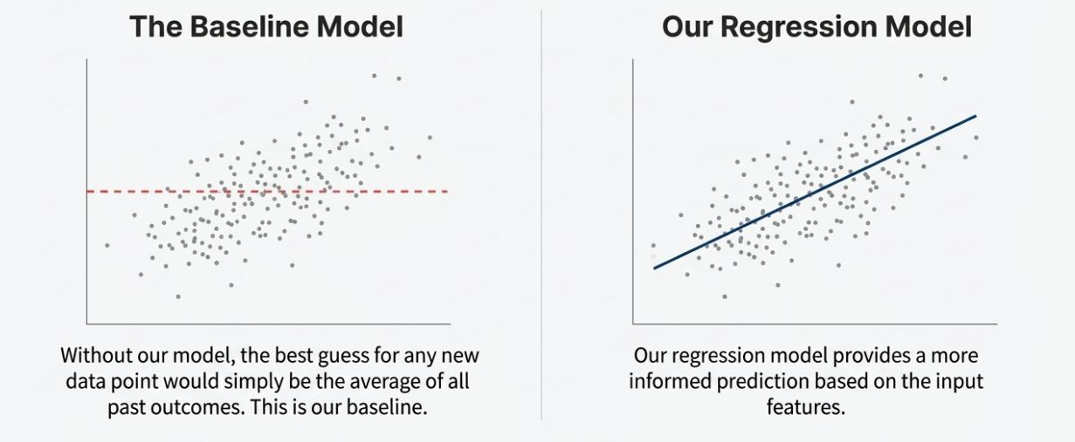
R-Square: How Much Better Are We Than The Average
R-squared measures how much better the regression line is at explaining the data compared to the simple mean line.

Slide 10
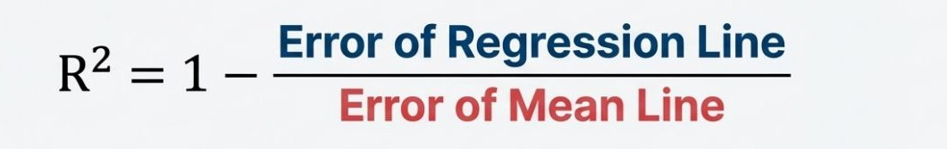
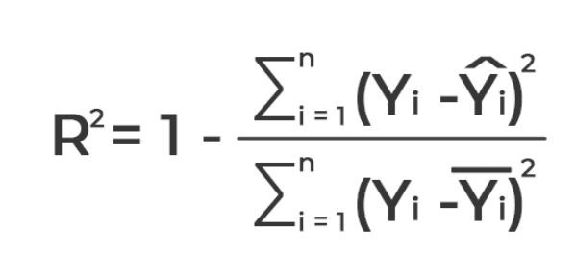
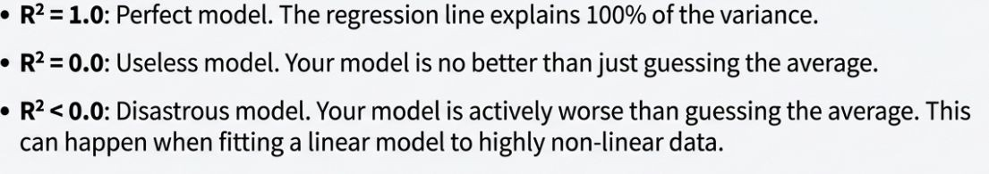
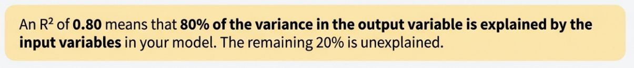
Interpreting R-Square Score

Slide 11
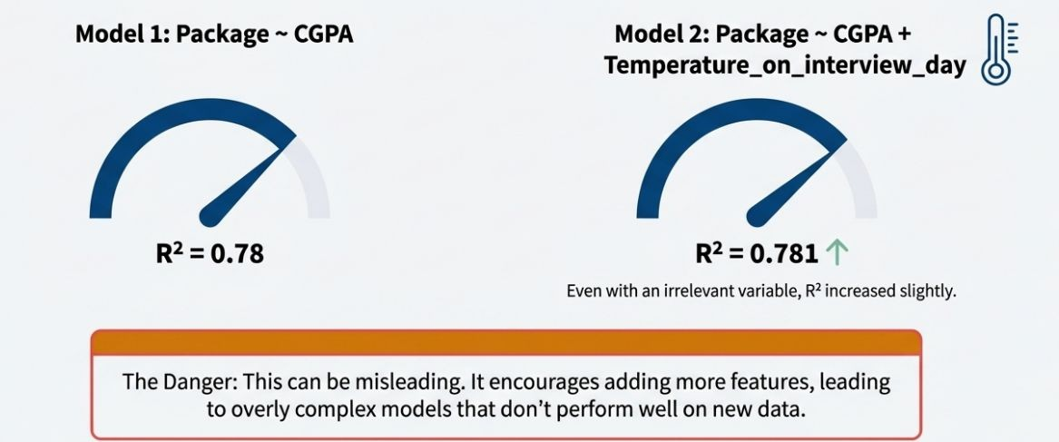
Flaw: R² Never Decreases
R² can only increase or stay the same when you add new variables to the model. It never goes down, even if the new variables are completely irrelevant.

Slide 12
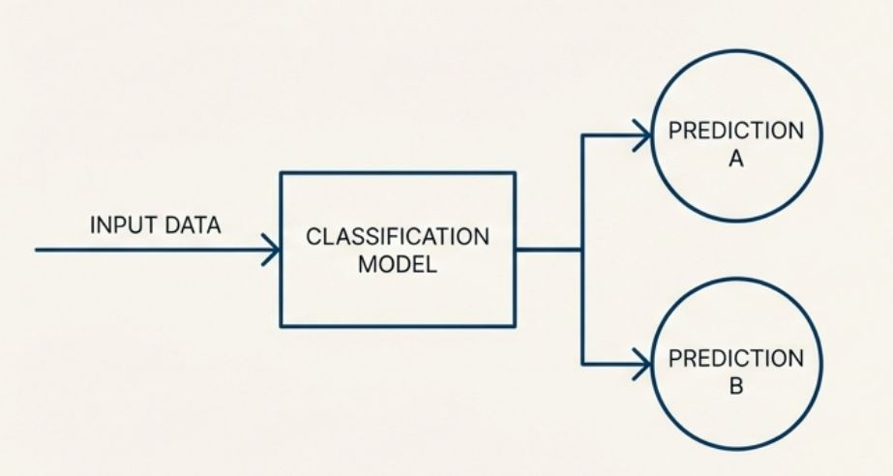
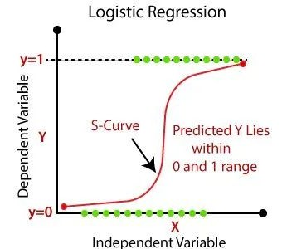
Classification Model

Slide 13
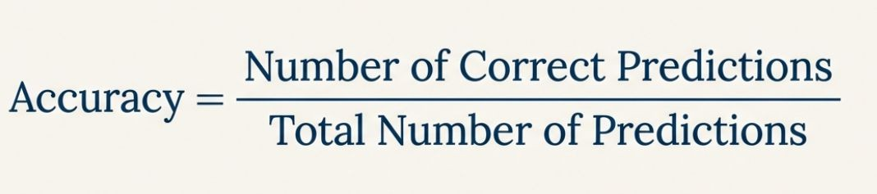
Accuracy

Slide 14
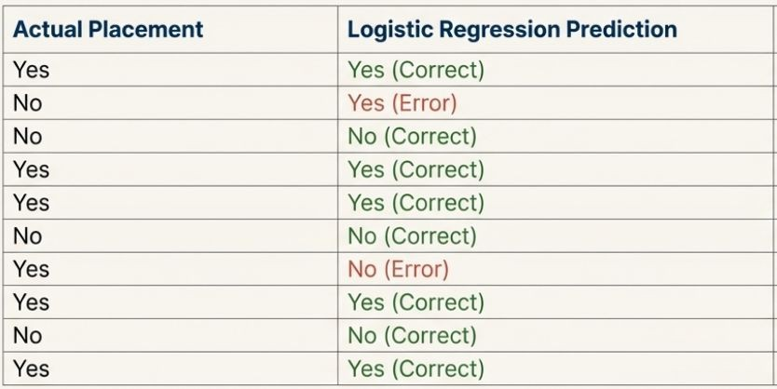
Accuracy Cont.
Logistic Regression Accuracy: 8 Correct / 10 Total = 80%

Slide 15
Accuracy on Imbalanced Data
Accuracy is most misleading when dealing with imbalanced datasets, where one class is far more common than the other.
Scenario: Airport Terrorist Screening
  In a dataset of 100,000 passengers, there is 1 terrorist.
  Data Balance: 99,999 'Normal' vs. 1 'Terrorist'
Now, consider a 'dumb' model with one simple rule: Predict that no one is a terrorist.
Accuracy Score: 99,999 / 100,000 = 99.999%

Slide 16
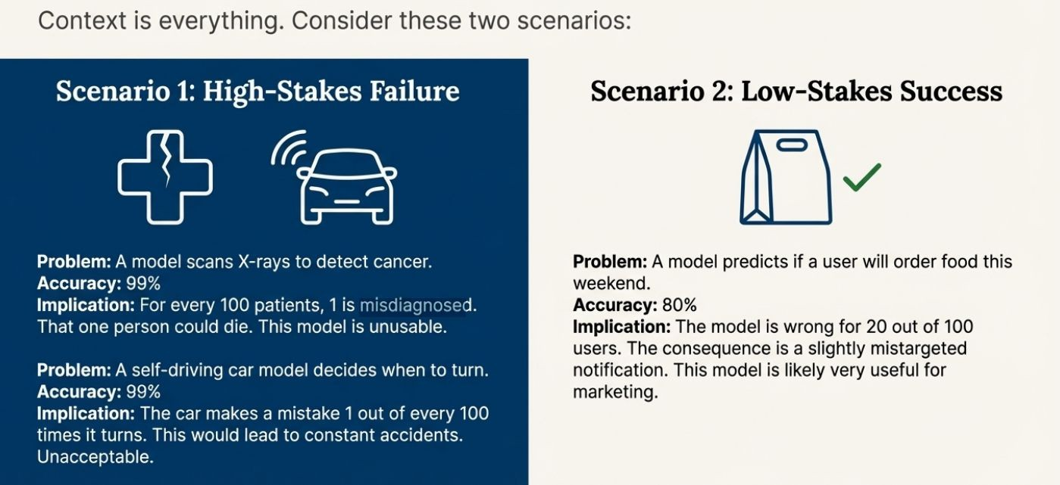
Why 99% Accuracy Can Be a Total Failure

Slide 17
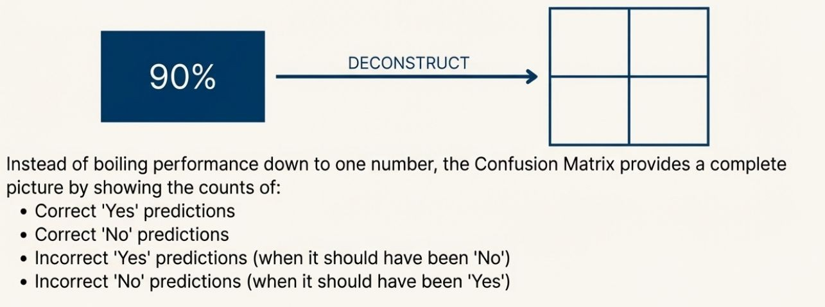
Confusion Matrix
Beyond a Single Score we need to know the nature of our models mistakes.

Slide 18
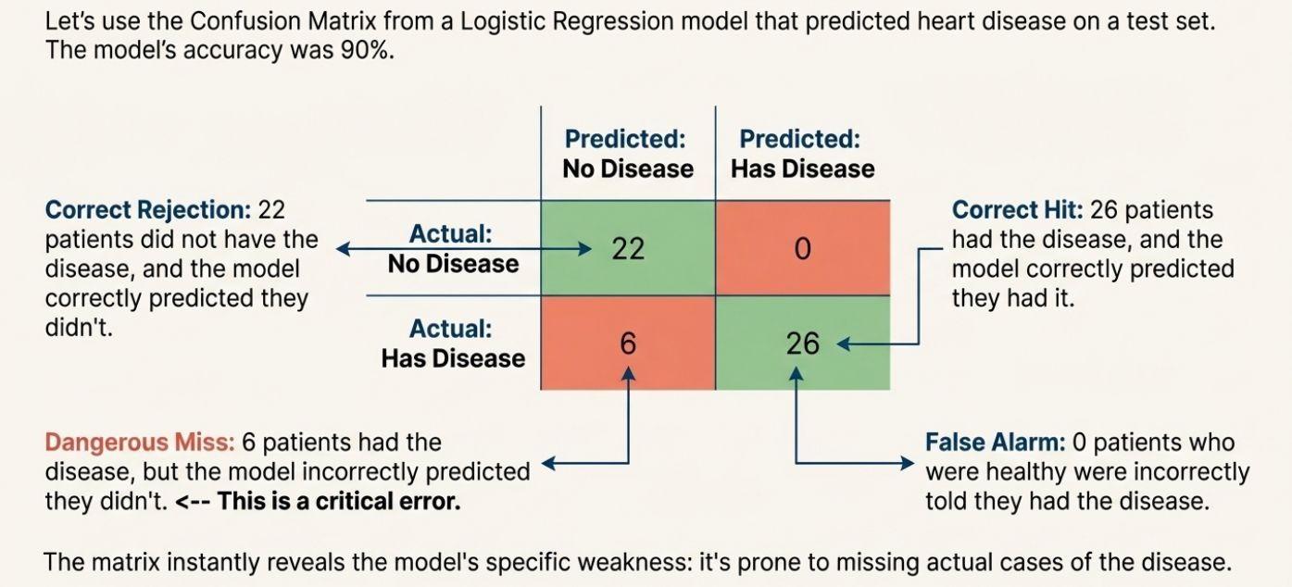


Confusion Matrix: Heart Disease Example

Slide 19
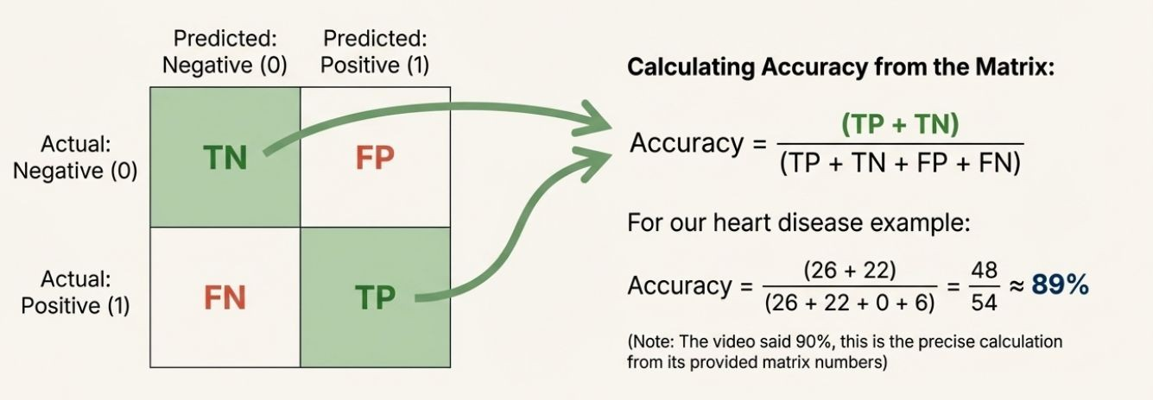

Confusion Matrix Cont.

Slide 20
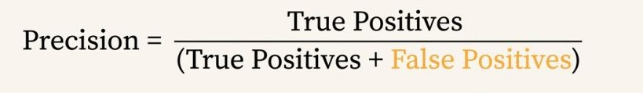
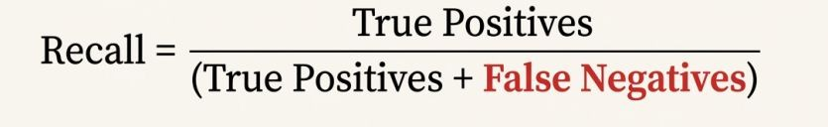
When accuracy fails, we must ask more precise questions.
Of all the items we predicted as positive, how many were actually positive ?
Of all the items that were actually positive, how many did our model correctly Identified ?
PRECISION: Measures the reliability of our positive predictions.
RECALL: Measures how completely we find all positives.

Slide 21

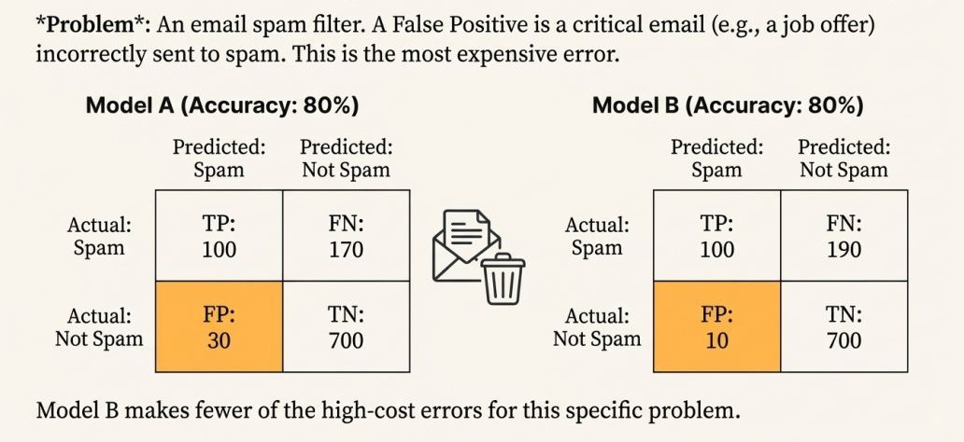
Case Study 1: Prioritizing Precision when False Positives are costly.
Problem:

Slide 22
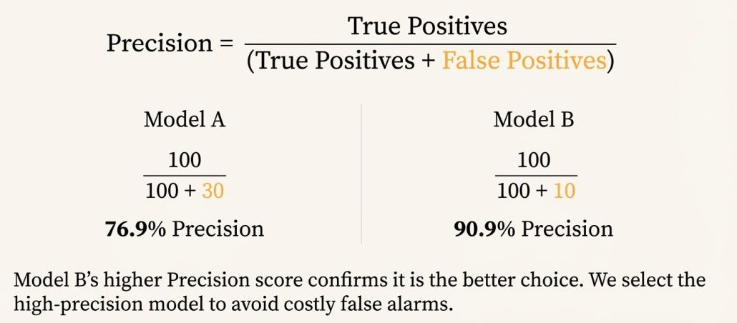
Precision Cont.

Slide 23
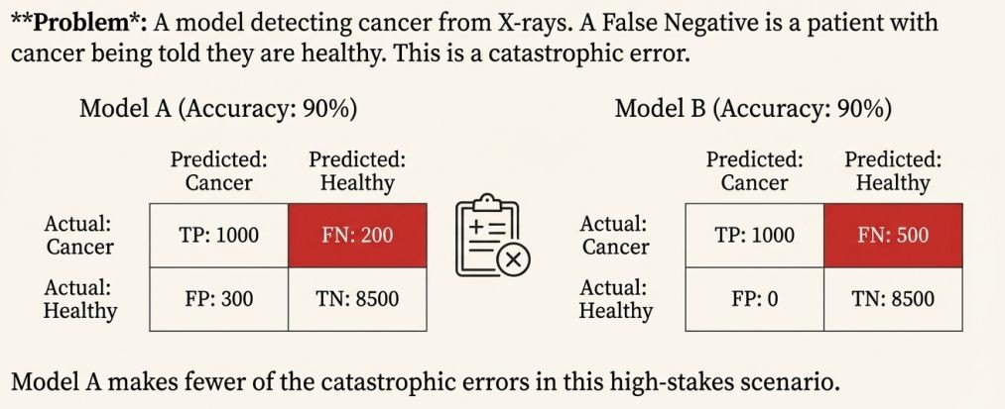

Case Study 2: Prioritizing Recall when False Negatives are costly.
Problem:

Slide 24
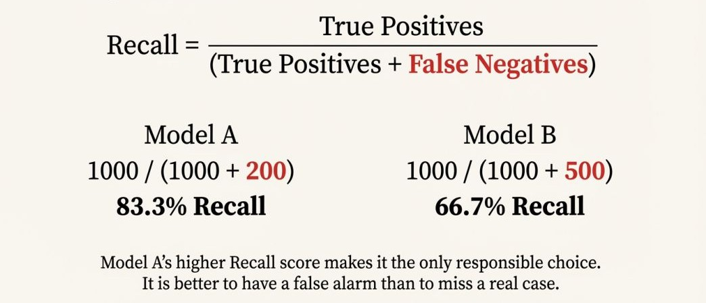
Recall Cont.

Slide 25
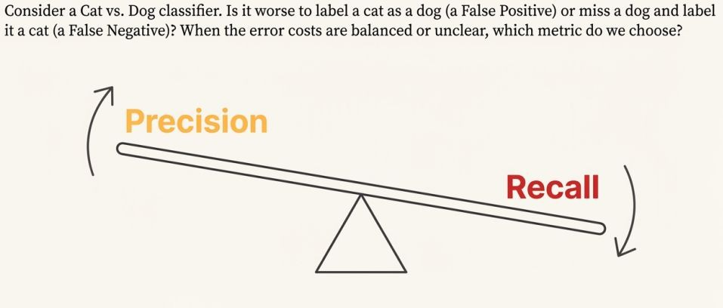
The challenge: Increasing Precision often reduces Recall and vice-versa.

Slide 26
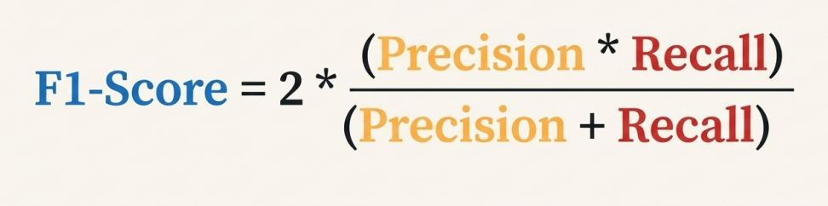
F1-Score
F1 is the harmonic mean of precision and recall.

Slide 27
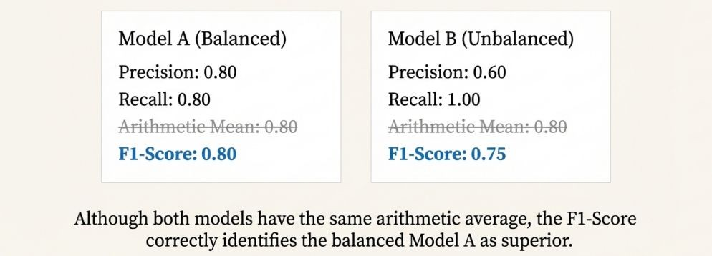
F1-Score cont.
F1 is the harmonic mean of precision and recall, not a simple average.
HM penalizes extreme imbalance between Precision and Recall

Slide 28
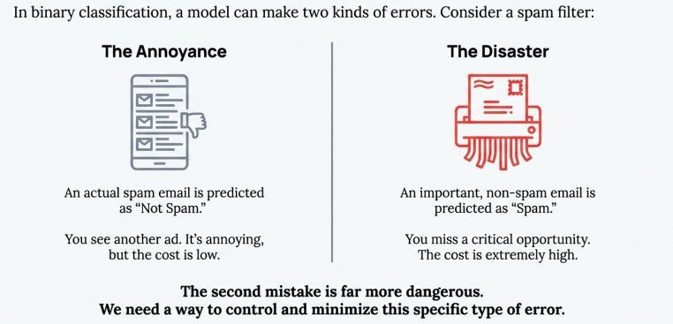
Optimal Threshold For Binary Classification
ROC Curve

Slide 29
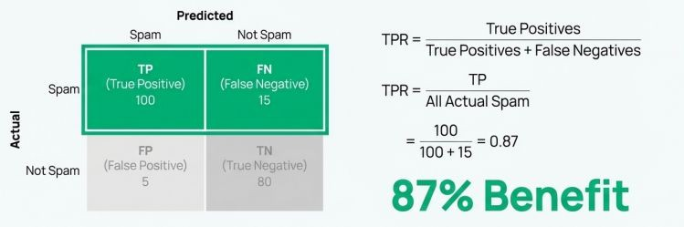
True Positive Rate (TPR): Benefit
TPR answers the question: "Of all the actual spam emails out there, what fraction did we successfully catch?" It measures the effectiveness, or benefit, of our model. Our goal is to make this as high as possible.

Slide 30
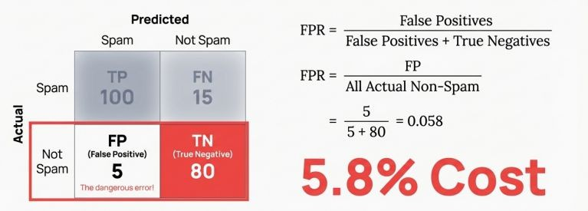
False Positive Rate (FPR): Cost
FPR answers the question: "Of all the important, non-spam emails, what fraction did we incorrectly send to the spam folder?" This is the cost or risk associated with our model. Our goal is to make this as low as possible.

Slide 31
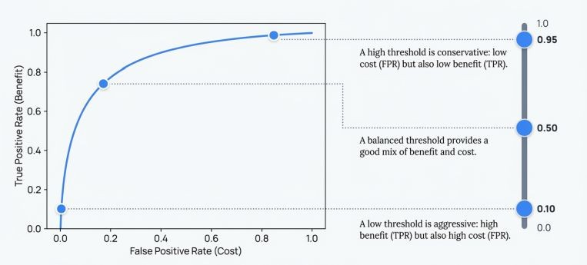
ROC Curve

Slide 32
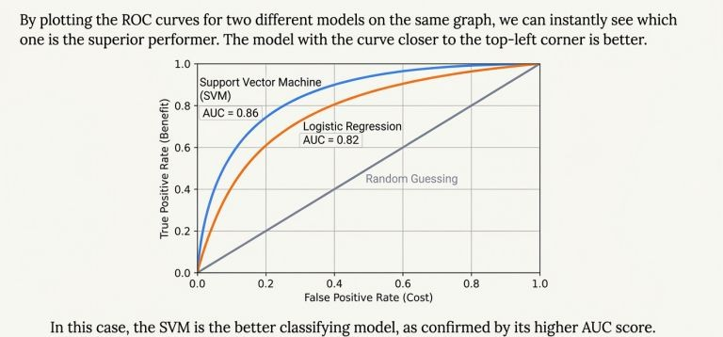
AUC

